Slide 1
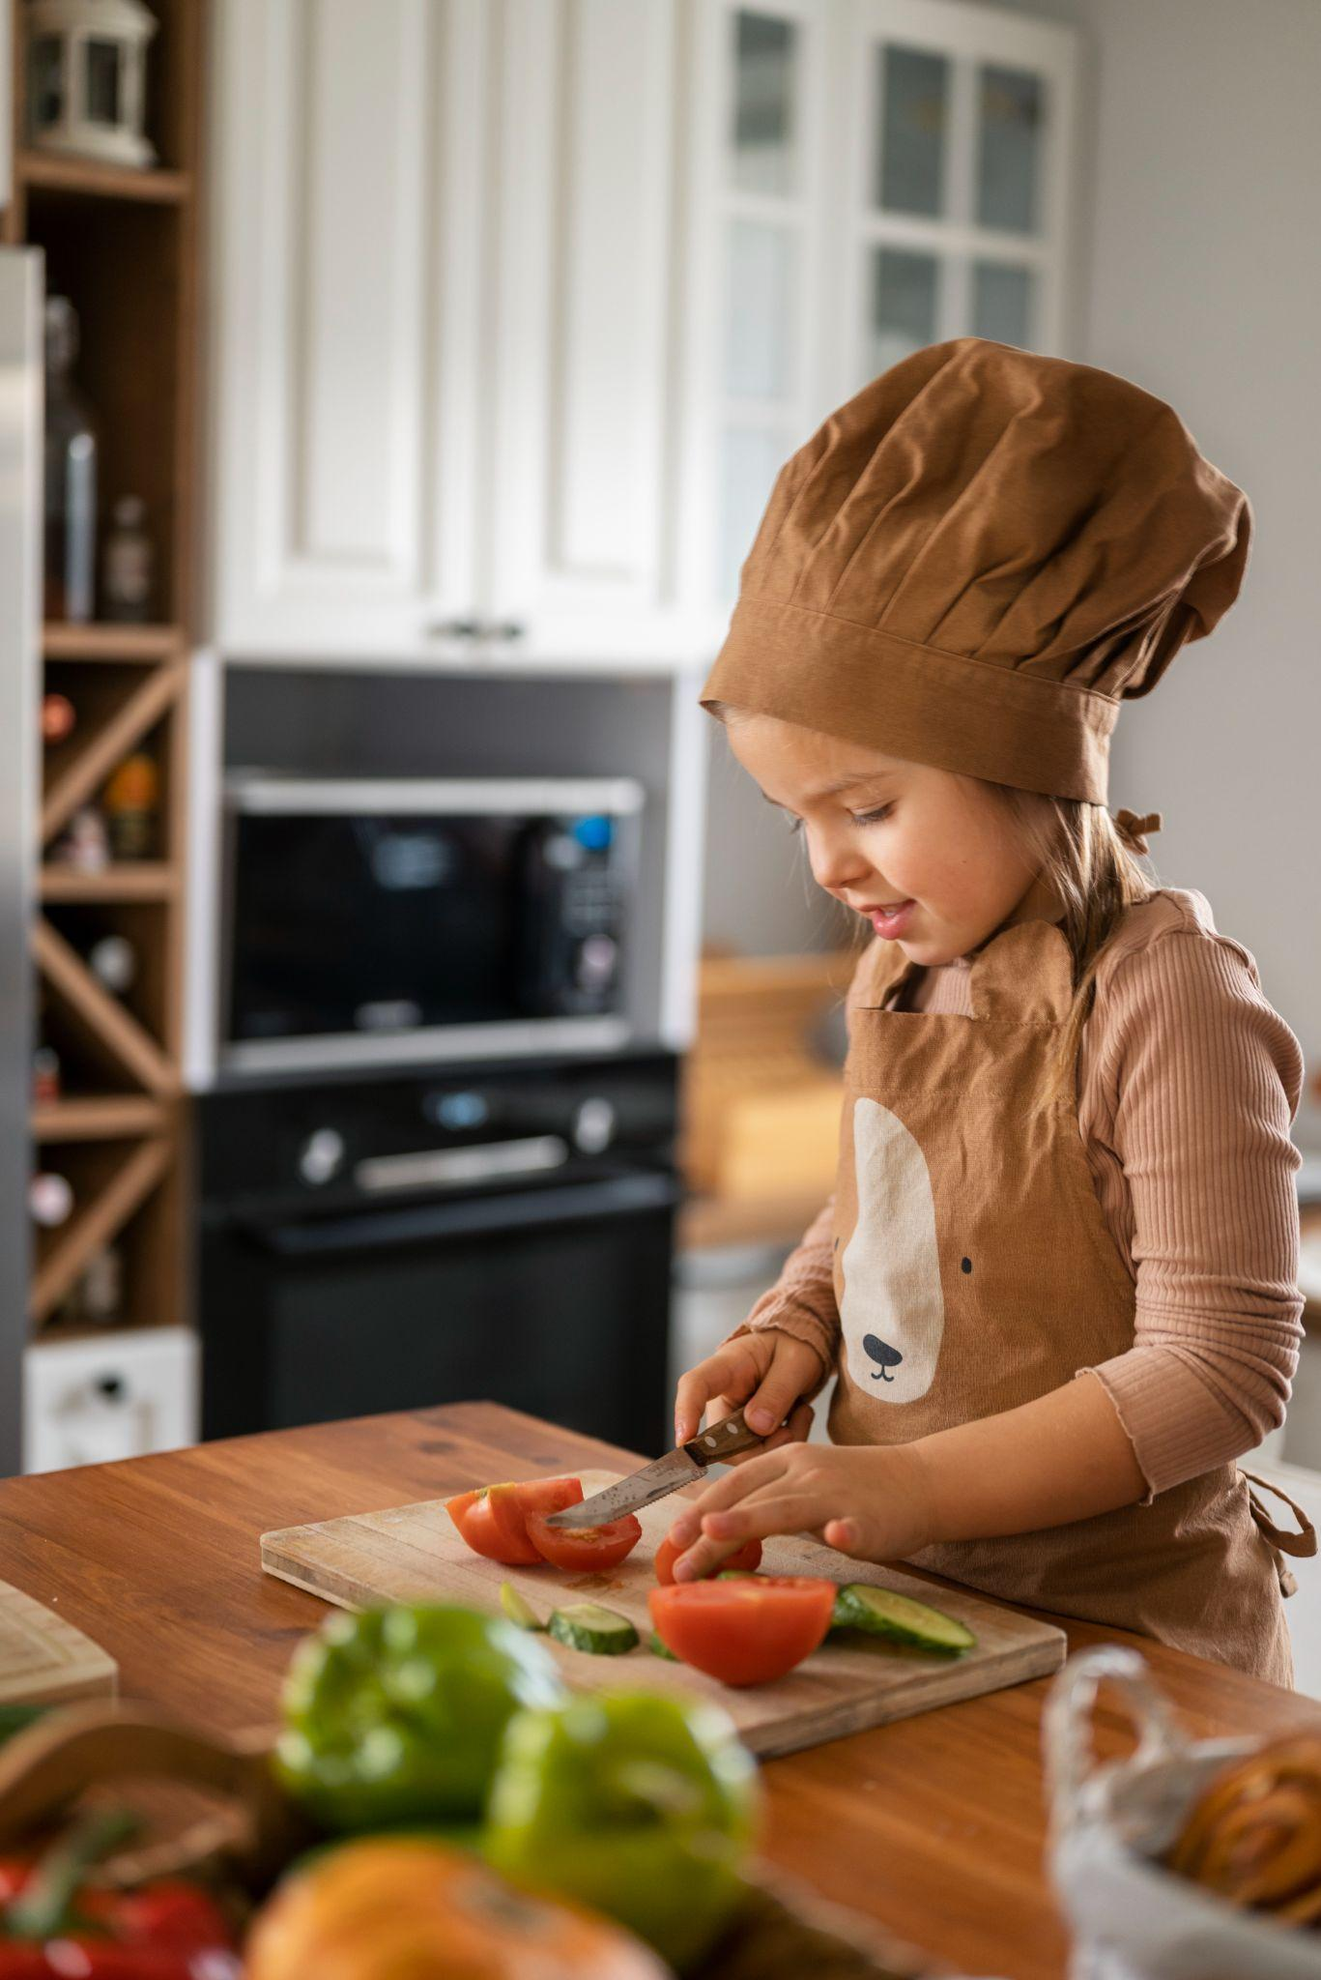
I Learn How to Prepare a Sandwich with the Teacher for Pre-K
Here is where your presentation begins

Slide 2
Contents of this template
You can delete this slide when you’re done editing the presentation
Fonts | To view the template correctly in PowerPoint, download and install the fonts we used
Used and alternative resources | An assortment of graphic resources that are suitable for use in this presentation
Thanks slide | You must keep it so that proper credits for our design are given
Colors | All the colors used in this presentation
Icons and infographic resources | These can be used in the template, and their size and color can be edited
Editable presentation theme | You can edit the master slides easily. For more info, click here
For more info: SLIDESGO | BLOG | FAQs
You can visit our sister projects: FREEPIK | FLATICON | STORYSET | WEPIK | VIDEVO

Slide 3
Table of contents
01
02
03
04
05
Introduction
Sandwiches
Ingredients
You can describe the topic of the section here
You can describe the topic of the section here
You can describe the topic of the section here
Tips to cook
Precautions
You can describe the topic of the section here
You can describe the topic of the section here

Slide 4
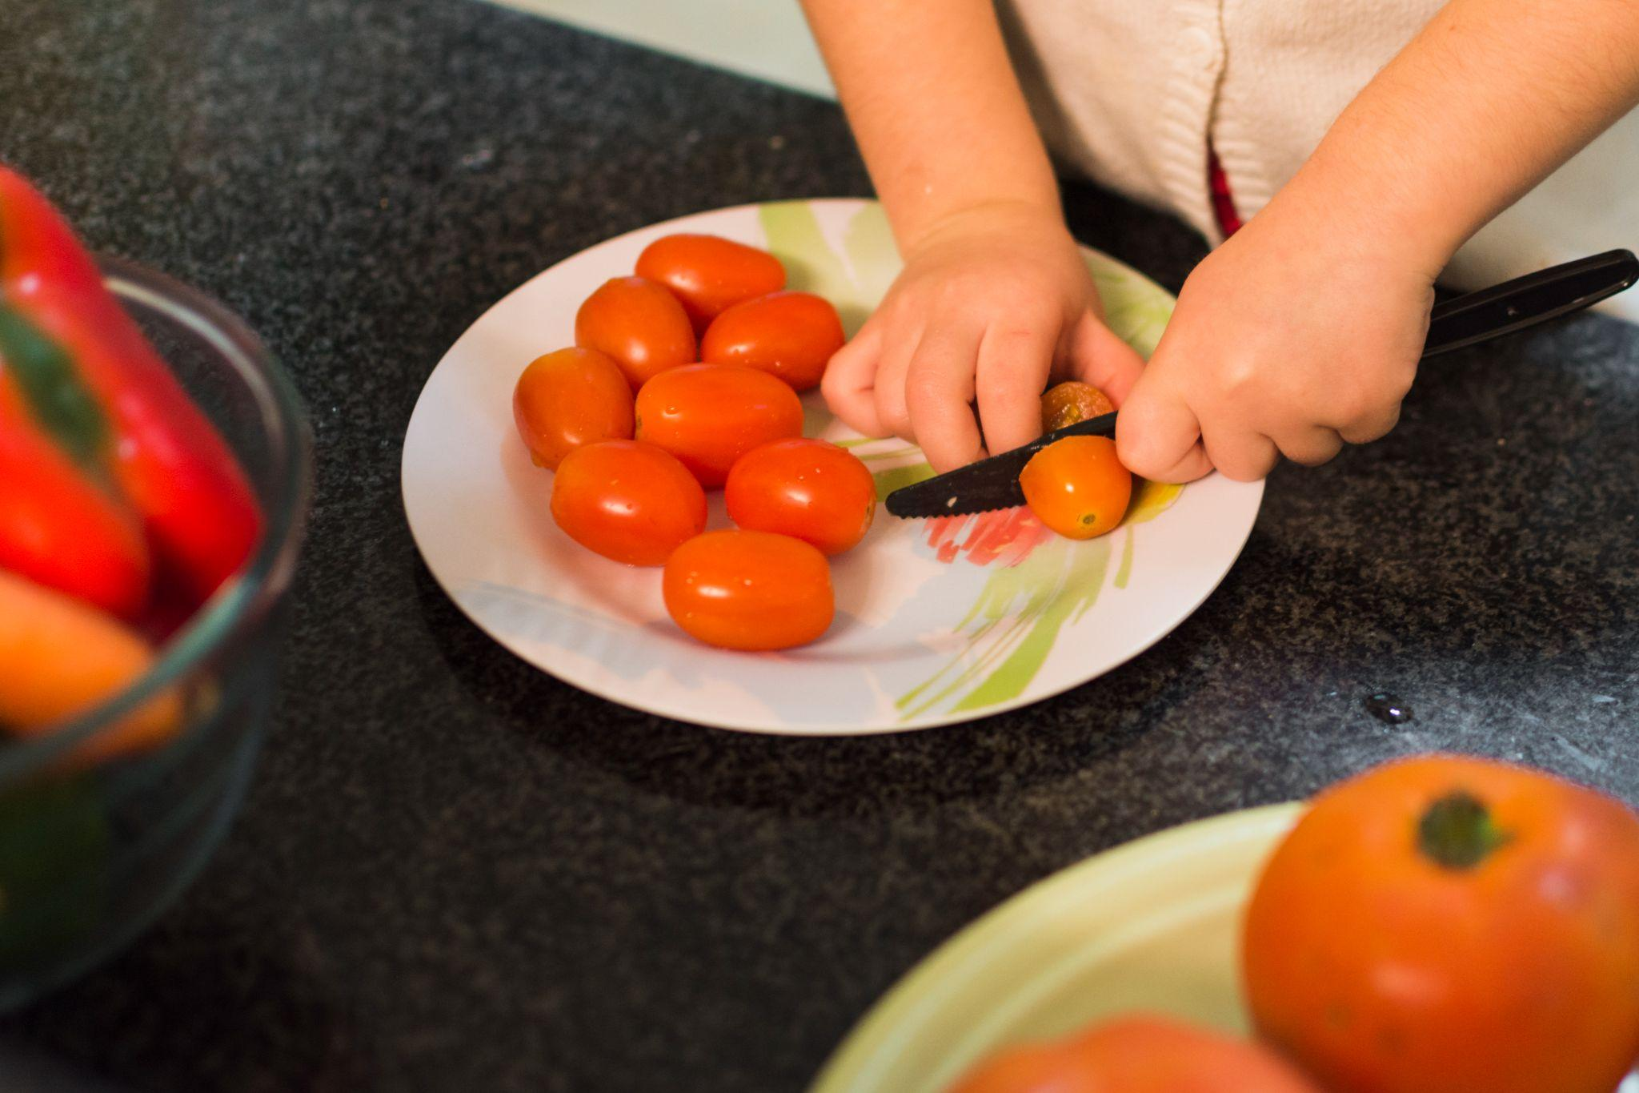
Whoa!
This can be the part of the presentation where you introduce yourself, write your email…

Slide 5
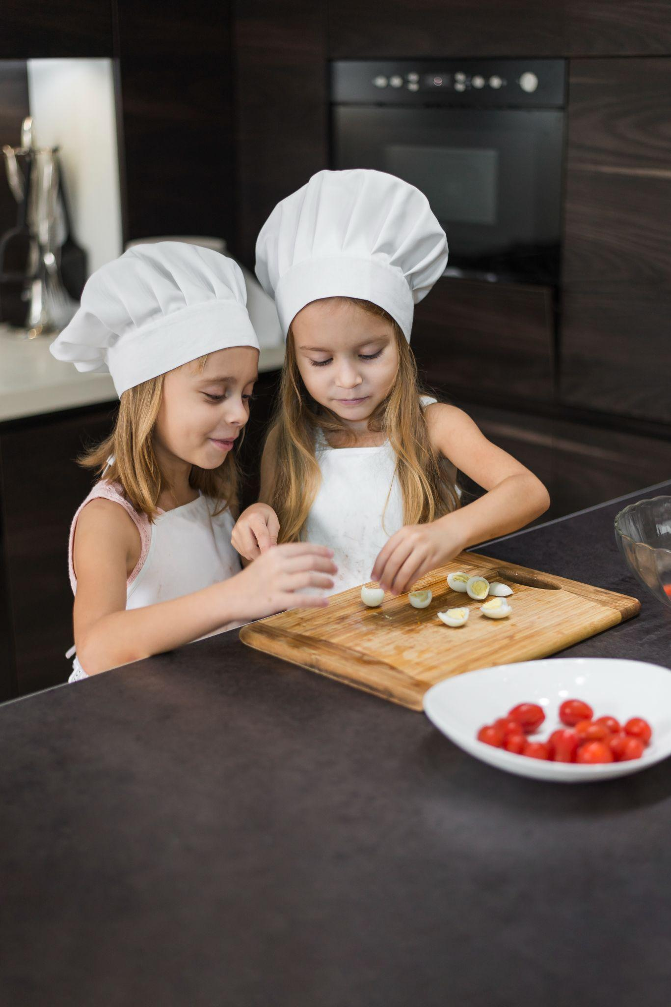
01
Introduction
You can enter a subtitle here if you need it

Slide 6
What is a sandwich?
Mercury is the closest planet to the Sun and the smallest one in the entire Solar System. Contrary to popular belief, this planet's name has nothing to do with the liquid metal. Mercury was, instead, named after the famous Roman god
Mercury takes a little more than 58 days to complete its rotation, so try to imagine how long days must be there! Since the temperatures are so extreme, albeit not as extreme as in Venus, Mercury has been deemed to be non-habitable for humans

Slide 7
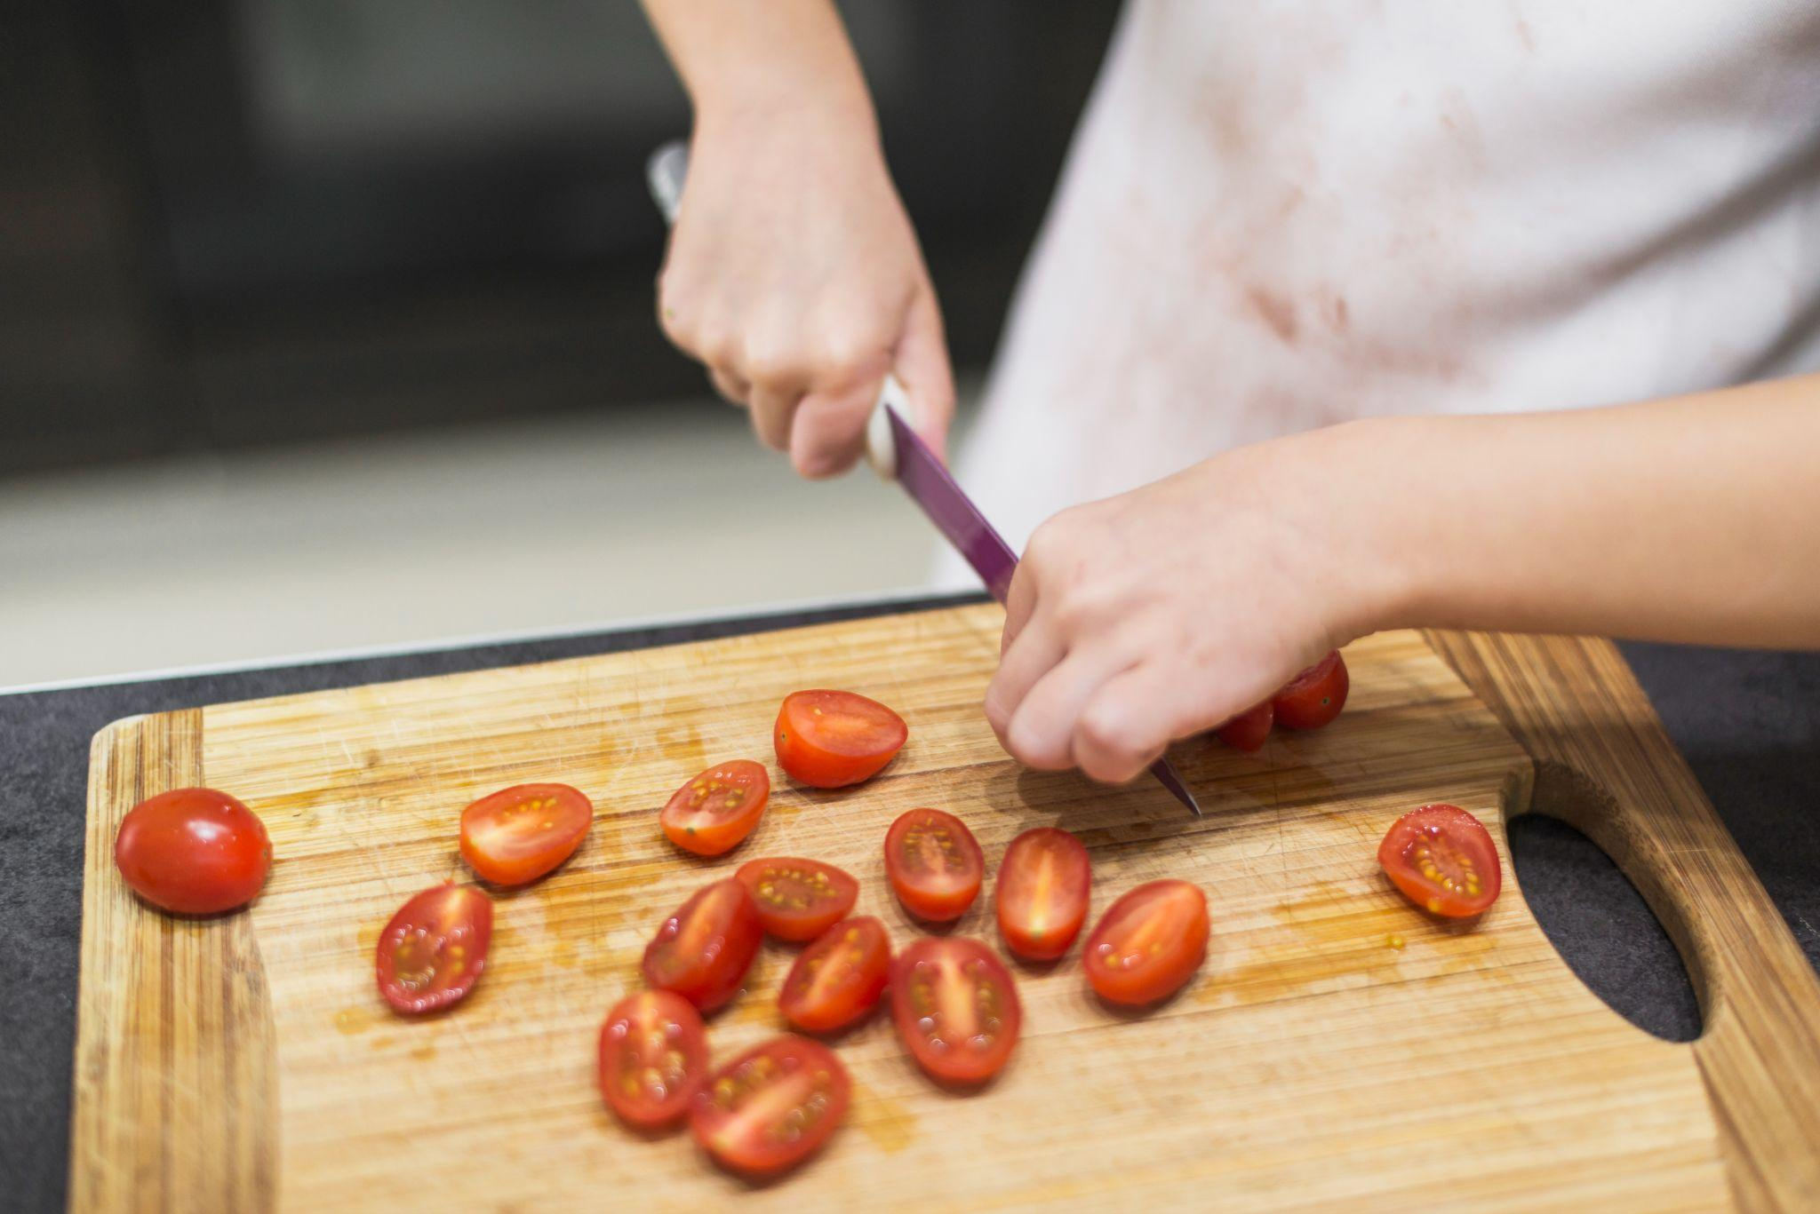
What are we going to do?
Do you know what helps you make your point crystal clear? Lists like this one:
They’re simple
You can organize your ideas clearly
You’ll never forget to buy milk!
And the most important thing: the audience won’t miss the point of your presentation

Slide 8
We must take care with:
Knifes
Hot stuff
Mercury is the closest planet to the Sun and the smallest one in the Solar System—it’s only a bit larger than the Moon
Venus has a beautiful name and is the second planet from the Sun. It’s hot and has a poisonous atmosphere

Slide 9
Activity 01: Create a recipe
Create a recipe for your sandwich and share it with your friends
Ingredients
200 g | Write the ingredient
1 tsp | Write the ingredient
2 tsp | Write the ingredient
400 g | Write the ingredient
Step 01
Step 02
Despite being red, Mars is very cold
Venus has extremely
high temperatures
Step 03
Step 04
Mercury is the closest planet to the Sun
Saturn is a gas giant with several rings

Slide 10
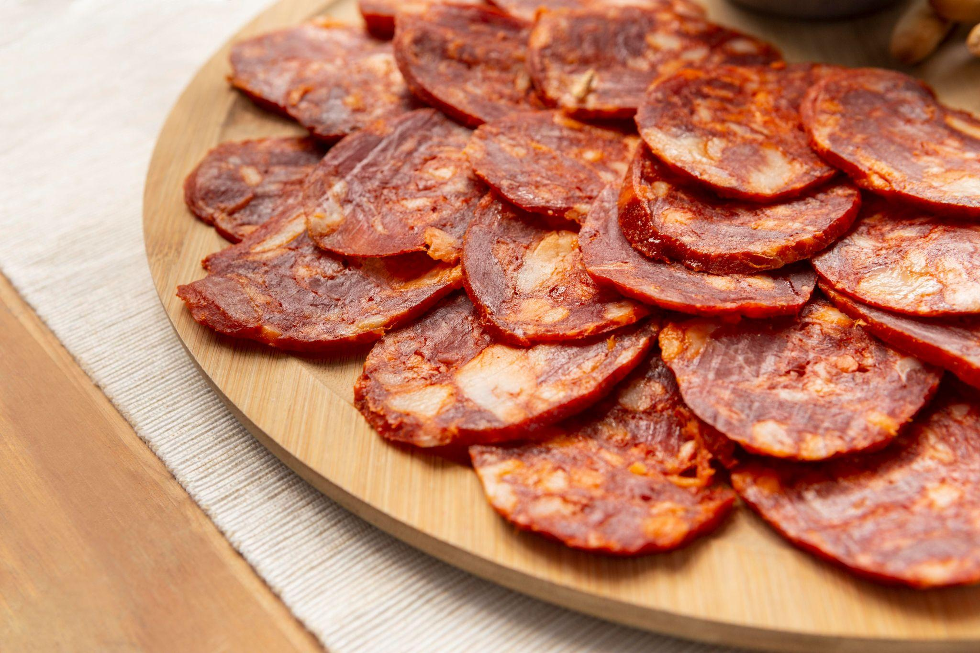
02
Sandwiches
You can enter a subtitle here if you need it

Slide 11
Perfect sandwiches for pre-k
Veggie sandwich
Club
sandwich
Ham & cheese
Mercury is the closest planet to the Sun and the smallest of them all
Venus has a beautiful name and is the second planet from the Sun
Despite being red, Mars is actually a cold place. It’s full of iron oxide dust

Slide 12
Elaboration timer schedule
Let's take a look at the time it takes to make the following sandwiches:
 | 00:00 | 00:10 | 00:20 | 00:30 | 00:40 | 00:50 | 01:00
01
02
03
04
05
Reuben sandwich
Club sandwich
Banh mi
Falafel sandwich
Katsu sando

Slide 13
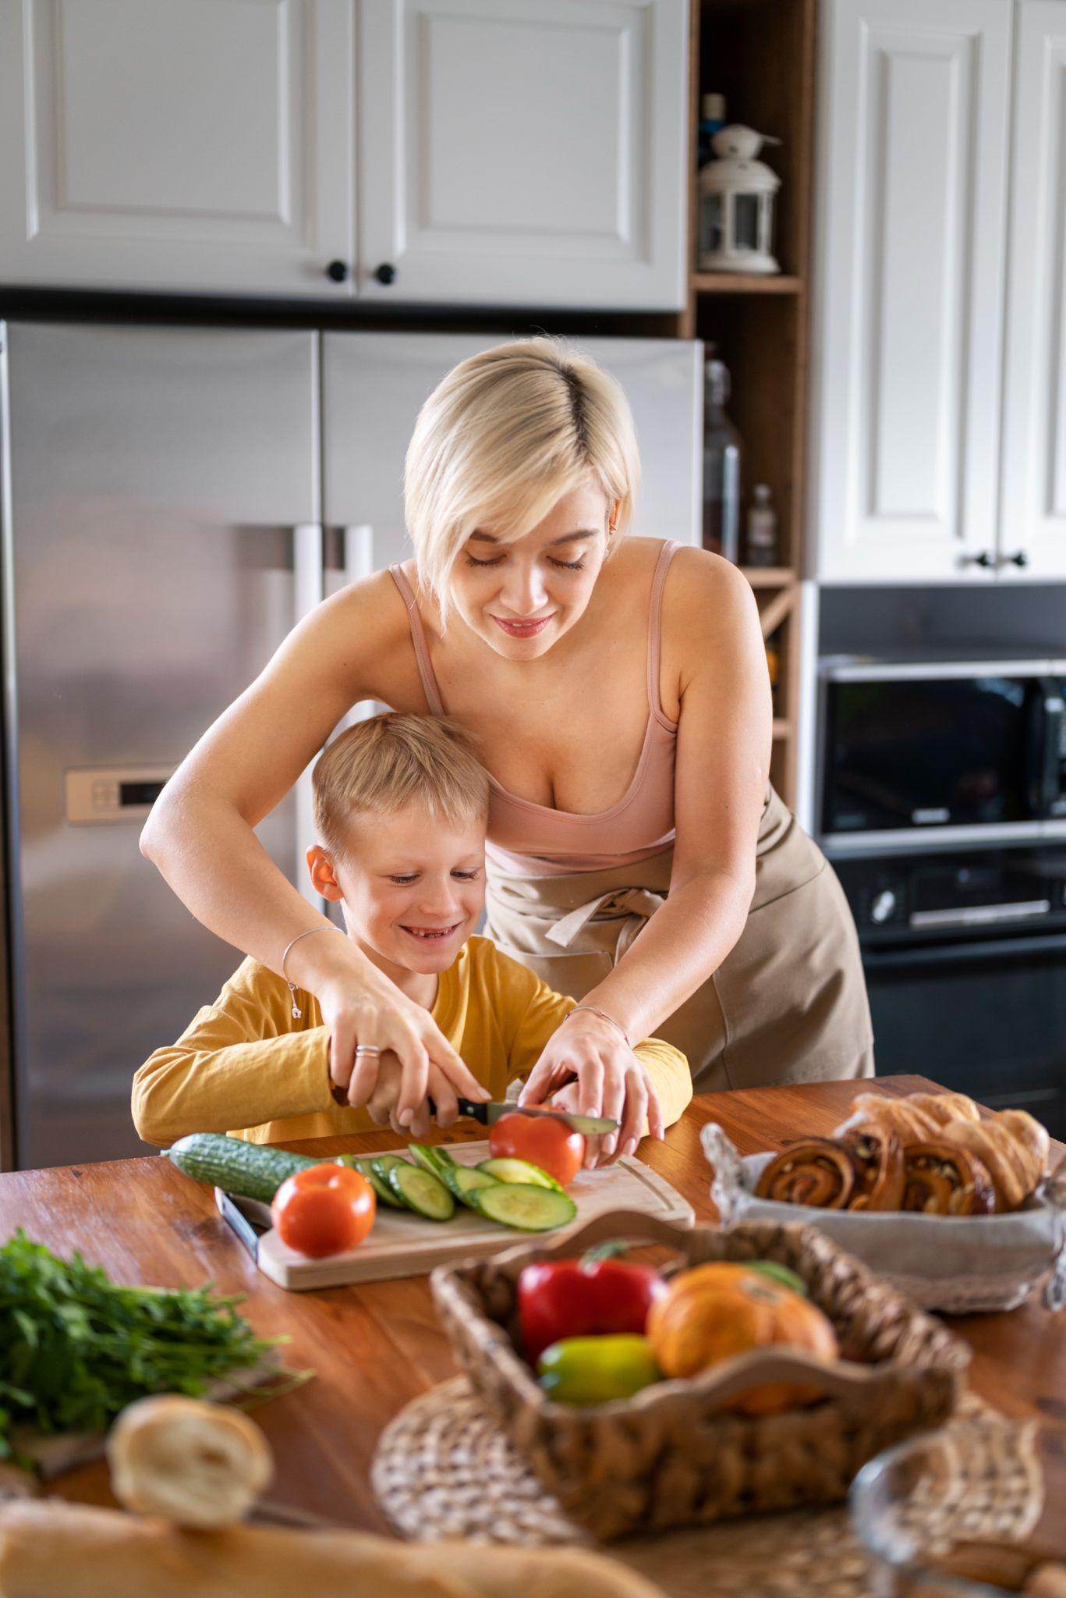
Let's get creative with them
Waffle sandwich
Tortilla wrap
Despite being red, Mars is a cold planet
Venus has extremely high temperatures
Bagel sandwich
Apple sandwich
Jupiter is the biggest planet of them all
Saturn is a gas giant and has several rings

Slide 14
Time to try new ingredients!
Avocado
Nuts
Pineapple
Despite being red, Mars is very cold
Venus has extremely high temperatures
Neptune is the farthest planet from the Sun
Peppers
Eggs
Seitan
Mercury is the closest planet to the Sun
Saturn is a gas giant with several rings
Jupiter is the biggest planet of them all

Slide 15
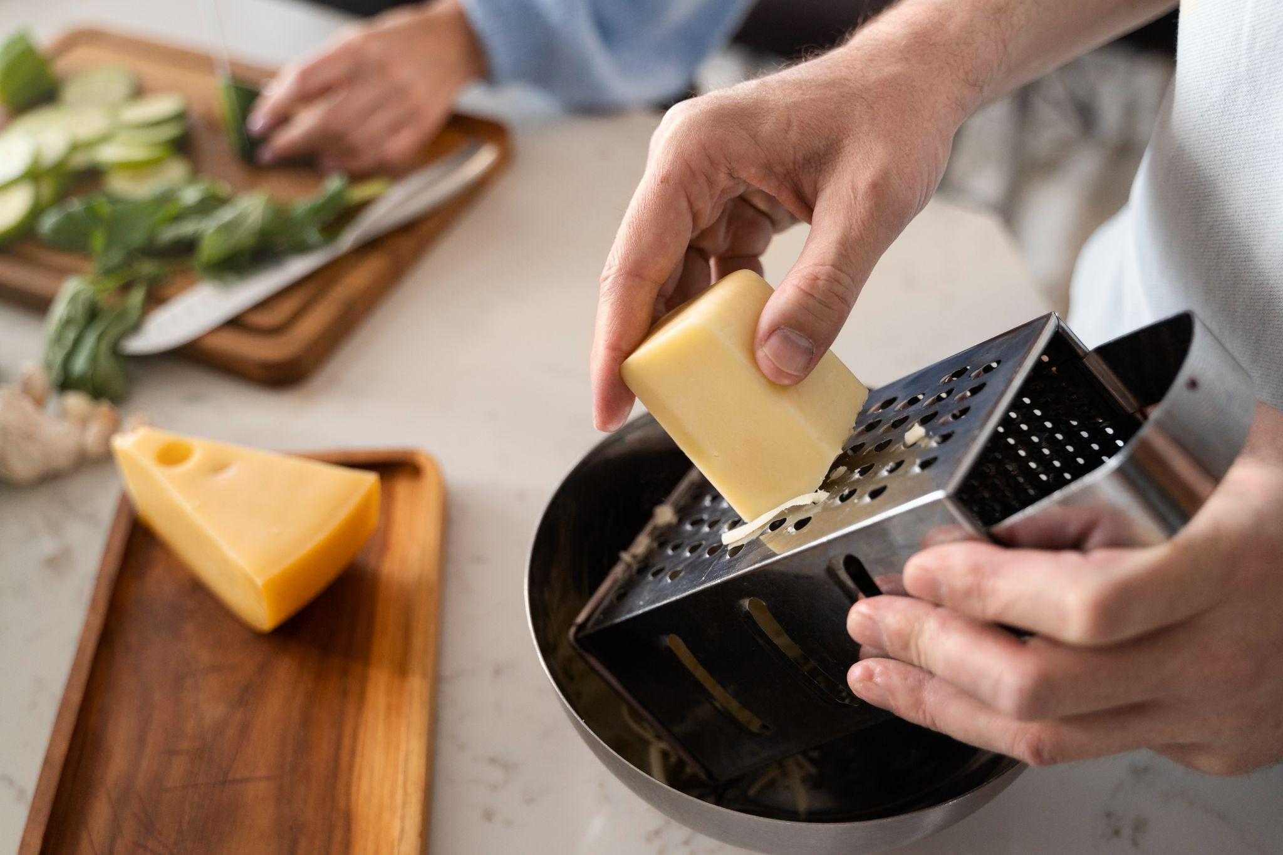
Awesome words

Slide 16
—Someone Famous
“This is a quote, words full of wisdom that someone important said and can make the reader get inspired”

Slide 17
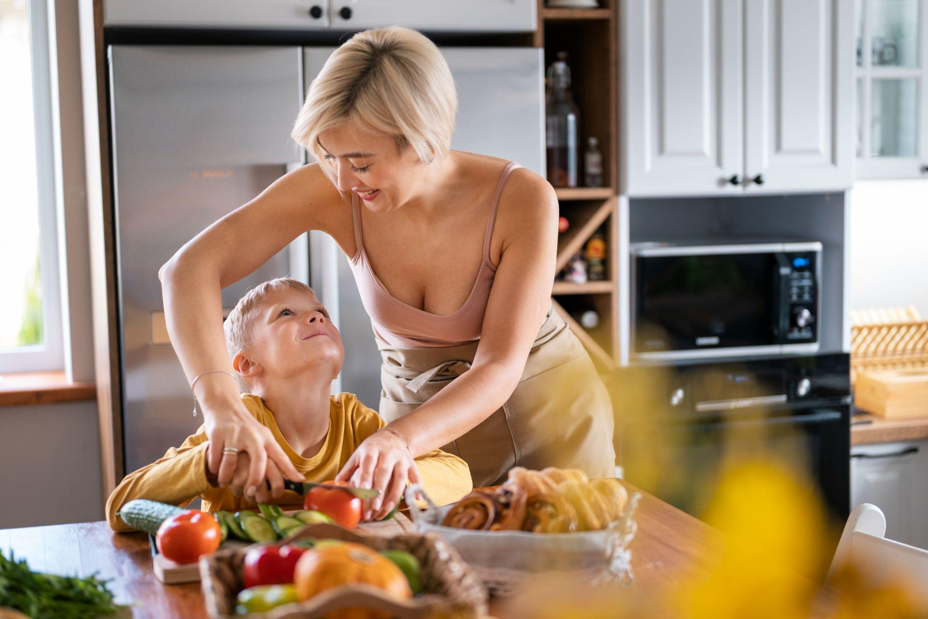
A picture is worth a thousand words

Slide 18
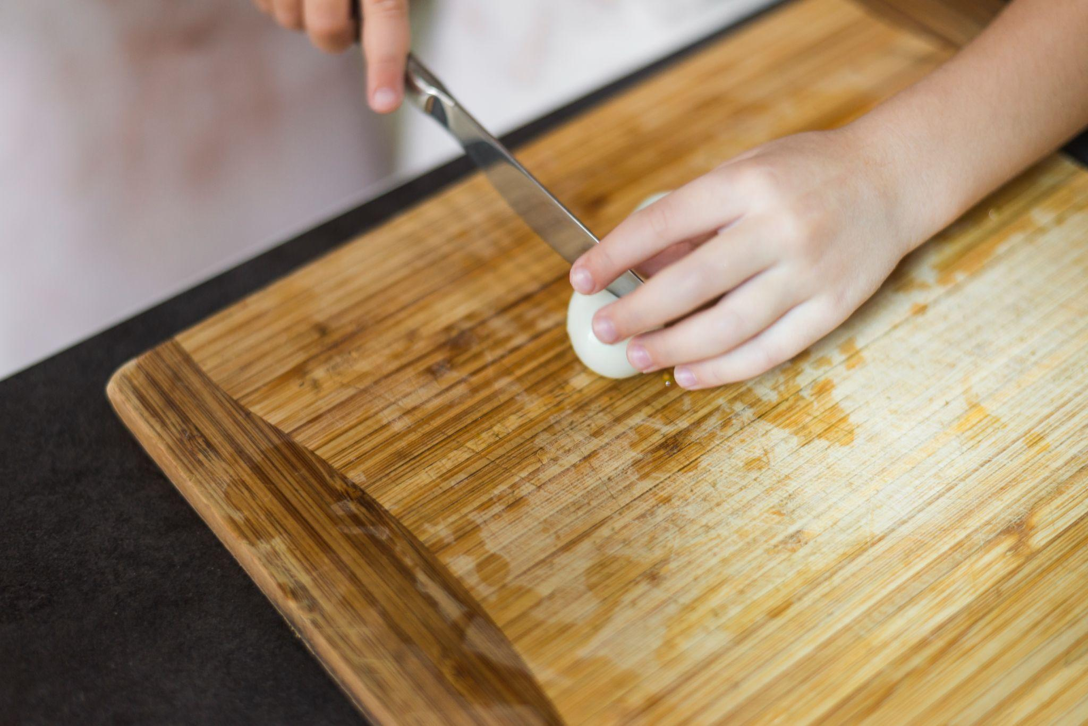
A picture always reinforces
the concept
Images reveal large amounts of data, so remember: use an image instead of a long text. Your audience will appreciate it

Slide 19
Activity 02: Time to cook!
Make the perfect sandwich with your teacher
Ingredients
Instructions
2 Slices of bread
Lettuce
Tomato
Cheese
Chorizo
Ham
Mayonnaise
Mustard
Ketchup
Choose your favorite bread. Take two slices of bread and put them on a plate
Add your favorite ingredients. You could add lettuce, tomato, cheese, ham, or any other ingredients
Spread some condiments. Take your favorite condiment like mayonnaise, mustard, ketchup
Layer your ingredients. You must follow the indications of your teacher
Cut and enjoy

Slide 20
98,300,000
Big numbers catch your audience’s attention

Slide 21
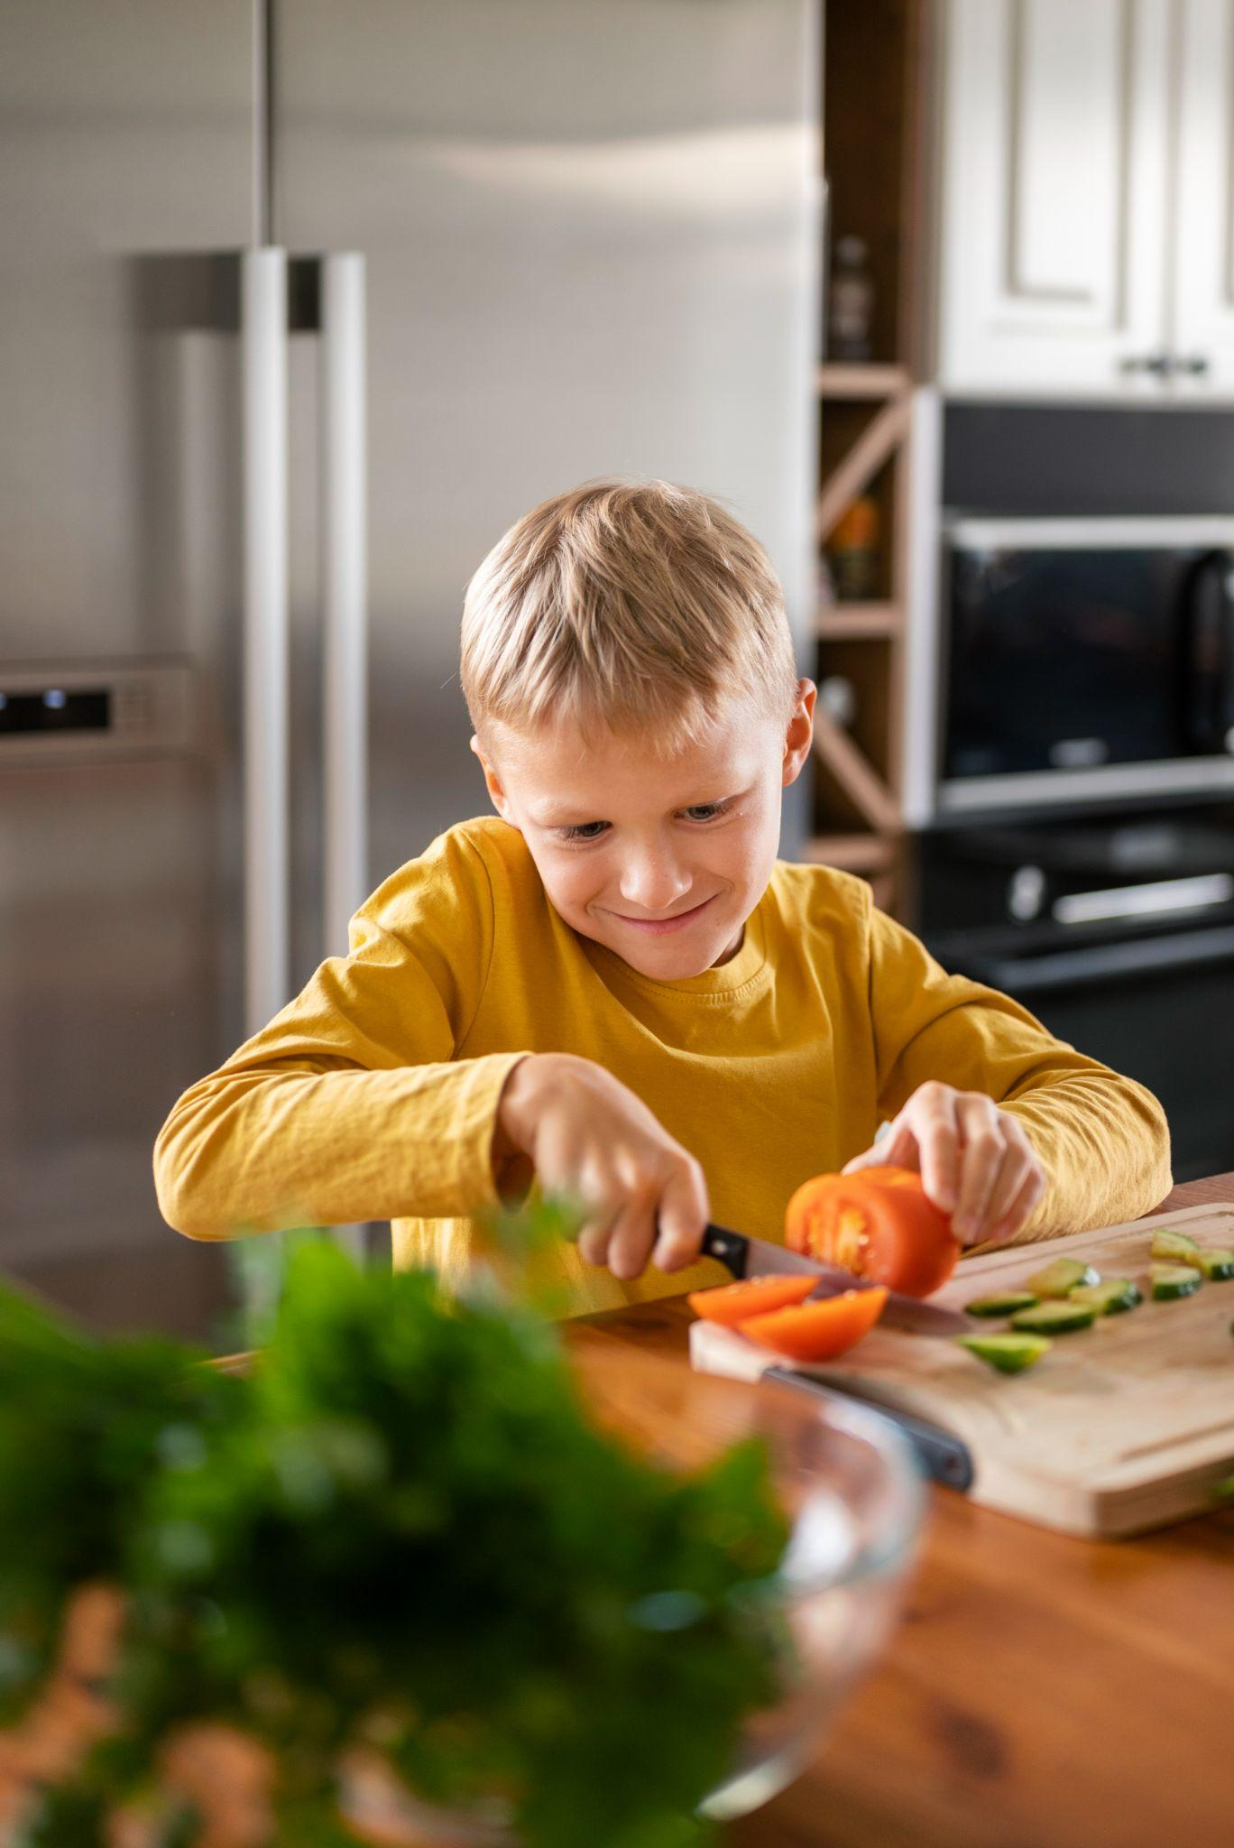
9h 55m 23s
333,000
386,000 km
Jupiter's rotation period
The Sun’s mass compared to Earth’s
Distance between Earth and the Moon

Slide 22
Perfect balance of a sandwich
10%
50%
40%
Condiments
Veggies
Proteins
Mercury is the closest planet to the Sun and the smallest of them all
Venus has a beautiful name and is the second planet from the Sun
Despite being red, Mars is actually a cold place. It’s full of iron oxide dust

Slide 23
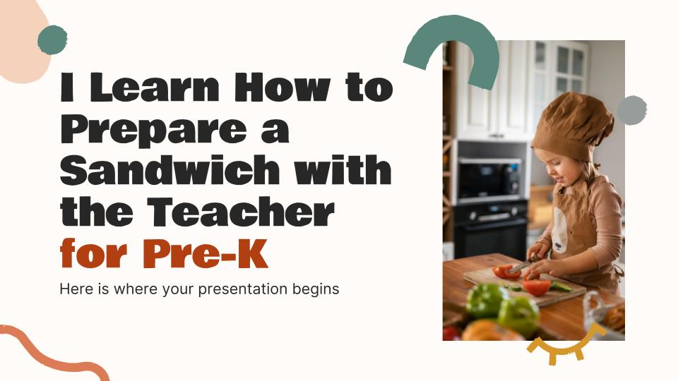
Computer mockup
You can replace the image on the screen with your own work. Just right-click on it and select “Replace image”

Slide 24
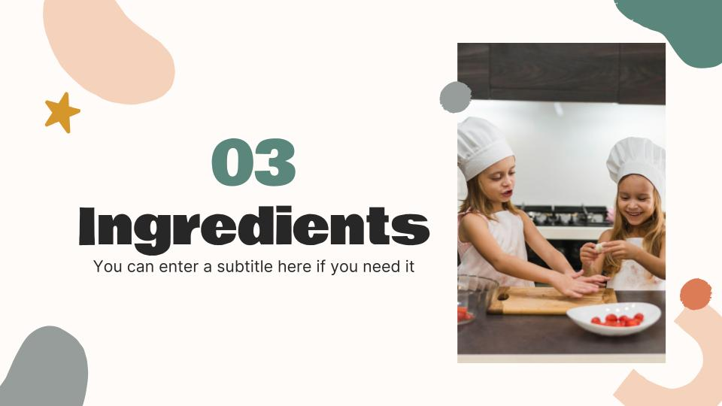
Tablet mockup
You can replace the image on the screen with your own work. Just right-click on it and select “Replace image”

Slide 25
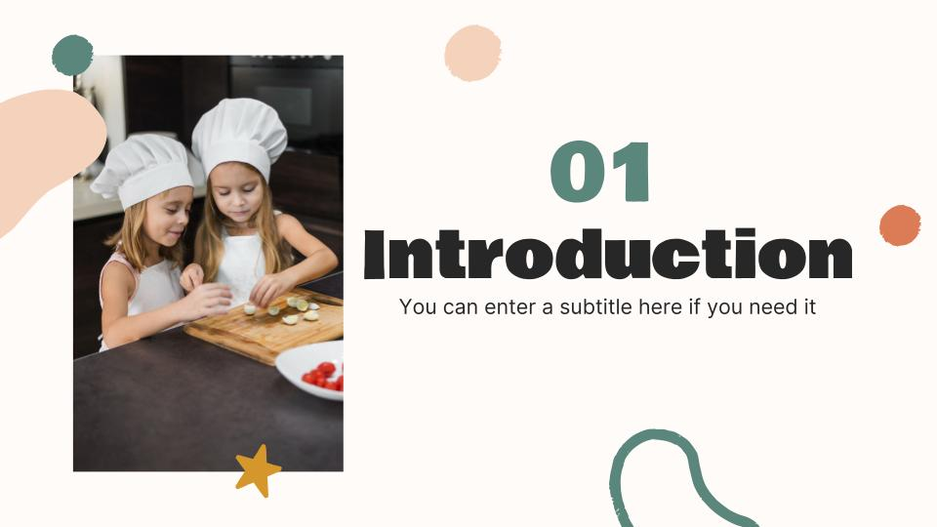
Smartphone mockup
You can replace the image on the screen with your own work. Just right-click on it and select “Replace image”

Slide 26
Sandwiches in the world
Michetta
Saturn is a gas giant with several rings
Chip Butty
Jupiter is the biggest planet of them all
Reuben
Venus has extremely high temperatures

Slide 27
From bread to spread
01
02
03
Despite being red, Mars is very cold
Venus has extremely high temperatures
Neptune is the farthest planet from the Sun
04
05
06
Mercury is the closest planet to the Sun
Saturn is a gas giant with several rings
Jupiter is the biggest planet of them all

Slide 28
Sandwich essentials
01
02
03
04
Bread
Sourdough
Rye
Ciabatta
Baguette
Focaccia
Veggies
Tomatoes
Onion
Pickles
Lettuce
Cucumber
Proteins
Ham
Bacon
Tuna
Salami
Cheese
Others
Ketchup
Mayonnaise
Peanut butter
Butter
Olive oil

Slide 29
Top favourite sandwiches
Write the name of the sandwiches you liked the most and rate them from one to ten
Top | Name |  |  | Points
01 | Insert the name of the sandwich |  |  | 10
02 | Insert the name of the sandwich |  |  | 8
03 | Insert the name of the sandwich |  |  | 6
04 | Insert the name of the sandwich |  |  | 4
05 | Insert the name of the sandwich |  |  | 2

Slide 30
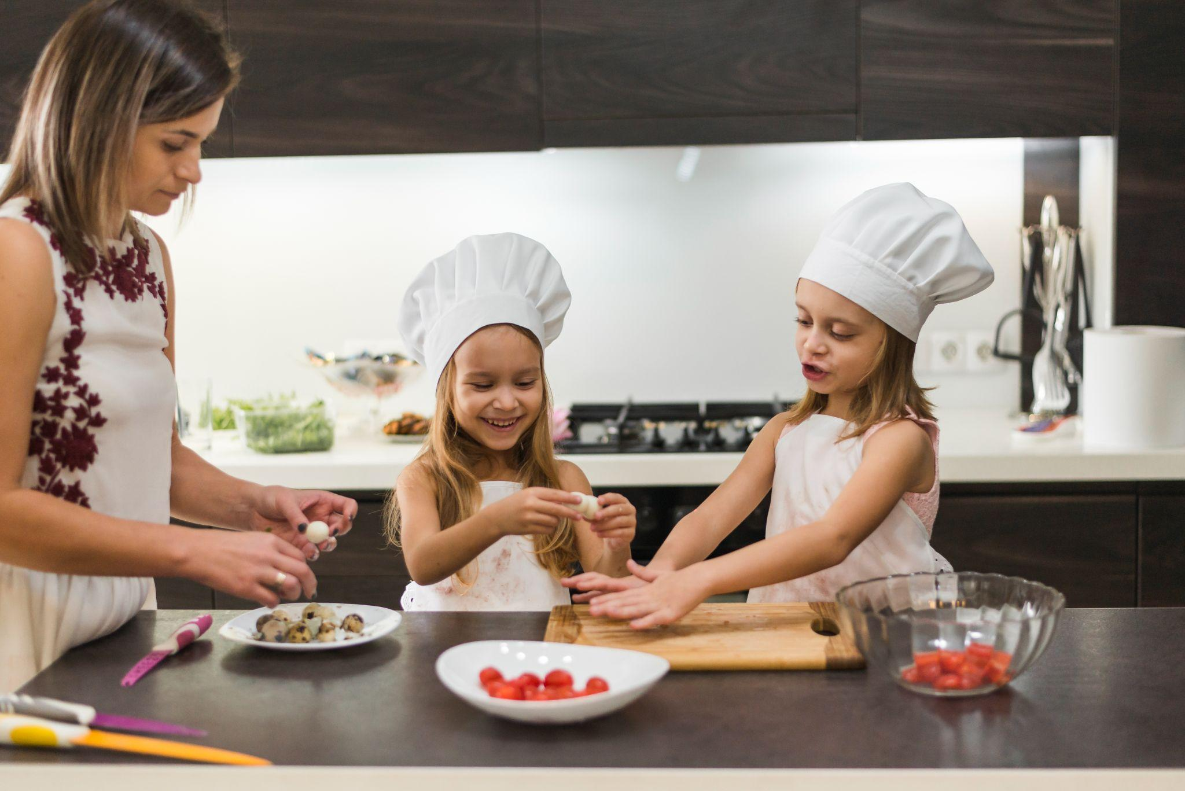
05
Precautions
You can enter a subtitle here if you need it

Slide 31
An adult must help me with...
Blender
Oven
Mercury is the closest planet to the Sun
Despite being red, Mars is a cold place
Stove
Microwave
Venus is the second planet from the Sun
Jupiter is the biggest planet of them all
Mixer
Knife
Earth is the only planet with life
Saturn has a high number of moons

Slide 32
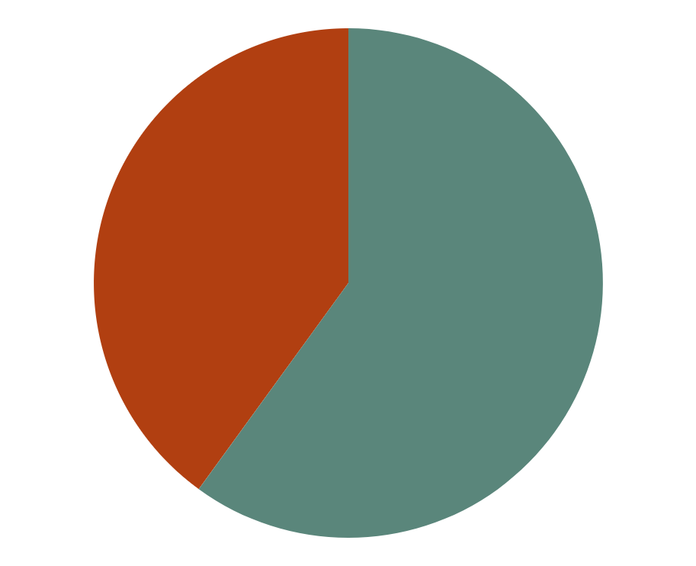
Success rate of the activity
60%
40%
Success
Failure
Venus has a beautiful name and is the second planet from the Sun
Despite being red, Mars is actually a cold place. It’s full of iron oxide dust
Follow the link in the graph to modify its data and then paste the new one here. For more info, click here

Slide 33
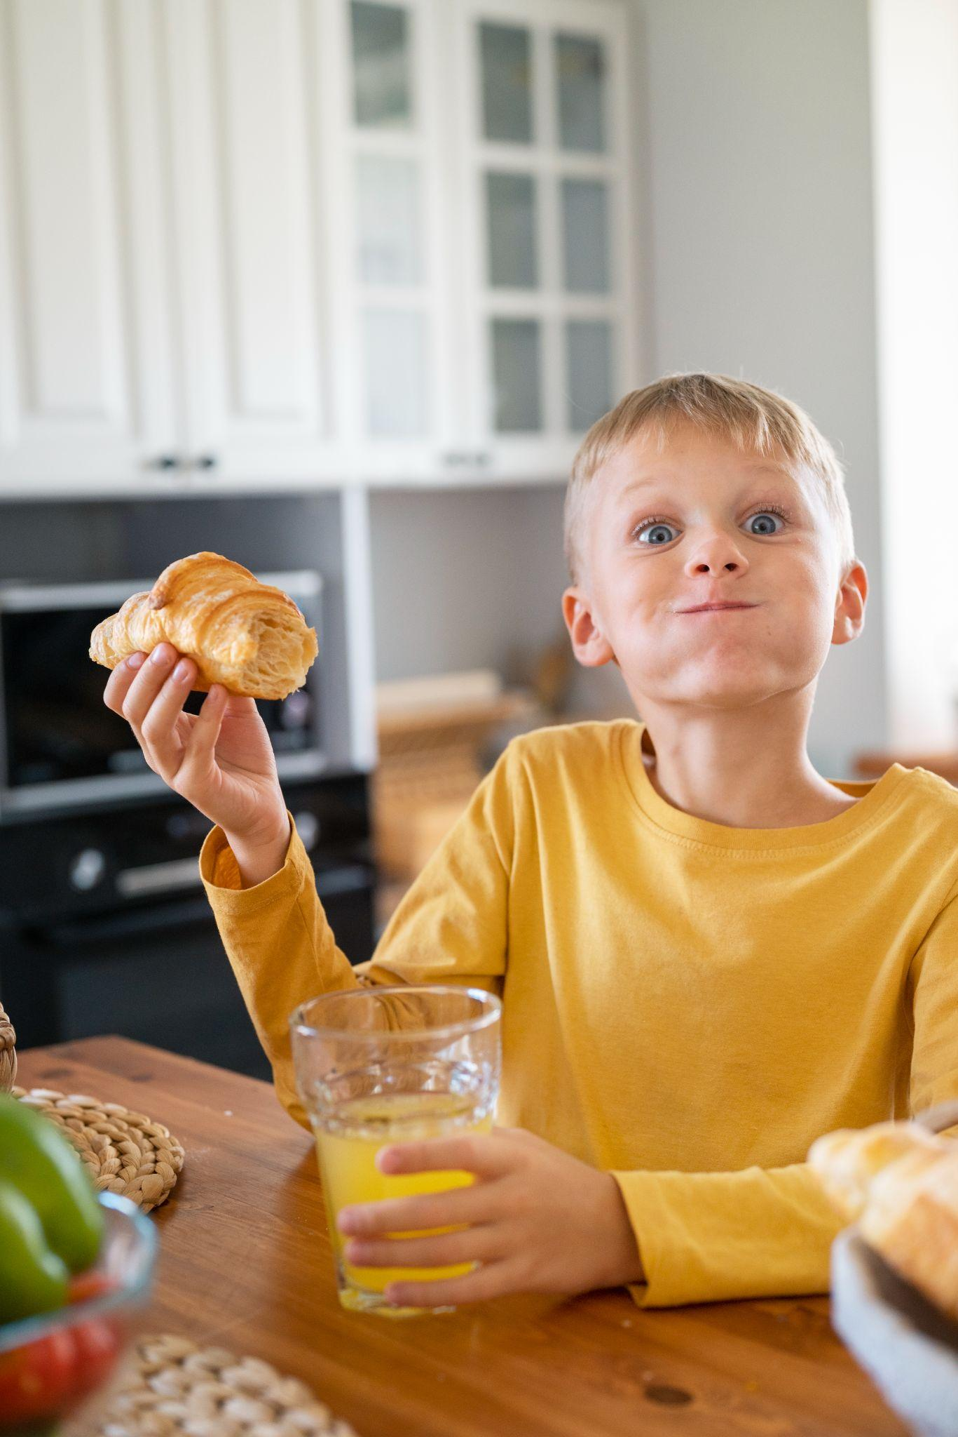
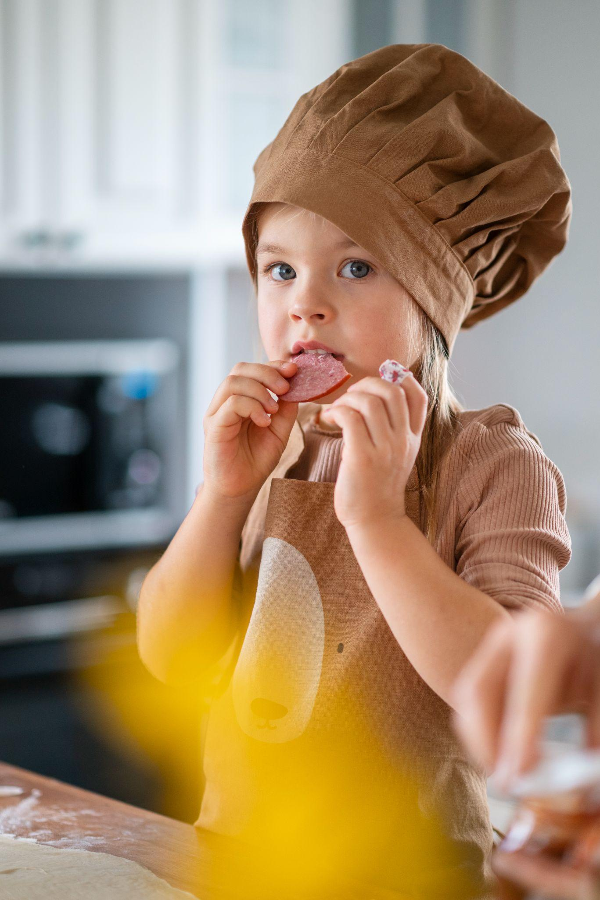
Little hands, big sandwiches
Jason Hill
Kaliyah Harris
You can speak a bit about this person here
You can speak a bit about this person here

Slide 34
Activity 03: True or false
Write true or false to the following sentences as appropriate
You should always wash your hands before making a sandwich | True
Pre-K students should use a sharp knife to slice the bread
It is important to choose fresh and nutritious ingredients
Peanut butter and jelly is the only option for a sandwich filling
Pre-K students should be supervised by an adult

Slide 35
Thanks!
Do you have any questions?
youremail@freepik.com
+34 654 321 432
yourwebsite.com
Please keep this slide for attribution

Slide 36
Icon pack: Cooking

Slide 37
Alternative resources
Here’s an assortment of alternative resources whose style fits the one of this template:
Photos
High angle kid making food
Adorable cute sisters in chef hat and aprons preparing food in kitchen
Portrait of kid eating sandwich
Kids eating hot dogs together
Young woman helping her daughter cutting the carrot with knife on wooden table
Close up kids eating sandwiches
Kid having fun cooking in the kitchen at home

Slide 38
Resources
Did you like the resources on this template? Get them for free at our other websites:
Icons
Icon Pack: Cooking | Filled
Vectors
Banner template for diy tutorials
Photos
Girl cutting tomatoes on plate over the kitchen worktop
Cute two siblings preparing food in kitchen
Close up on ingredients used for cooking
Delicious chorizo sliced on a plate arrangement
Kid cooking and having fun at home
Kid cooking and having fun at home II
Kid cooking and having fun at home III
Kid having fun cooking in the kitchen at home
Kid having fun cooking in the kitchen at home II
Girl's hand cutting boiled egg with knife on cutting board
Close-up of a girl's hand cutting tomatoes with knife on cutting board
Mother teaching her children to cook at home
Mother and smiling cute daughter peeling boiled quail eggs on kitchen worktop

Slide 39
Instructions for use
If you have a free account, in order to use this template, you must credit Slidesgo by keeping the Thanks slide. Please refer to the next slide to read the instructions for premium users.
As a Free user, you are allowed to:
Modify this template.
Use it for both personal and commercial projects.
You are not allowed to:
Sublicense, sell or rent any of Slidesgo Content (or a modified version of Slidesgo Content).
Distribute Slidesgo Content unless it has been expressly authorized by Slidesgo.
Include Slidesgo Content in an online or offline database or file.
Offer Slidesgo templates (or modified versions of Slidesgo templates) for download.
Acquire the copyright of Slidesgo Content.
For more information about editing slides, please read our FAQs or visit our blog:
https://slidesgo.com/faqs and https://slidesgo.com/slidesgo-school

Slide 40
Instructions for use (premium users)
As a Premium user, you can use this template without attributing Slidesgo or keeping the Thanks slide.
You are allowed to:
Modify this template.
Use it for both personal and commercial purposes.
Hide or delete the “Thanks” slide and the mention to Slidesgo in the credits.
Share this template in an editable format with people who are not part of your team.
You are not allowed to:
Sublicense, sell or rent this Slidesgo Template (or a modified version of this Slidesgo Template).
Distribute this Slidesgo Template (or a modified version of this Slidesgo Template) or include it in a database or in any other product or service that offers downloadable images, icons or presentations that may be subject to distribution or resale.
Use any of the elements that are part of this Slidesgo Template in an isolated and separated way from this Template.
Register any of the elements that are part of this template as a trademark or logo, or register it as a work in an intellectual property registry or similar.
For more information about editing slides, please read our FAQs or visit our blog:
https://slidesgo.com/faqs and https://slidesgo.com/slidesgo-school

Slide 41
Fonts & colors used
This presentation has been made using the following fonts:
Bowly One
(https://fonts.google.com/specimen/Bowlby+One)
Inter
(https://fonts.google.com/specimen/Inter)
#272727
#fffbf8
#d5962c
#5a867b
#f5d2bc
#db7c56
#979d9b
#b13f11

Slide 42

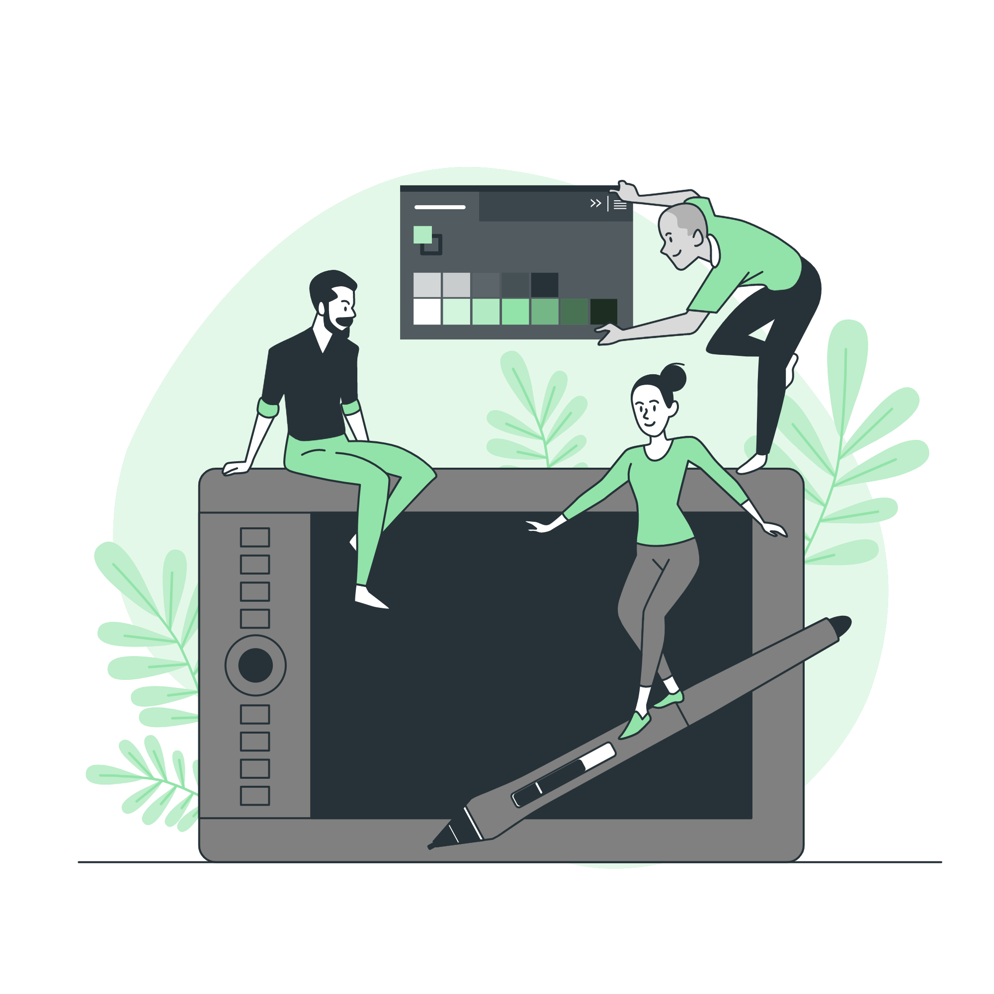

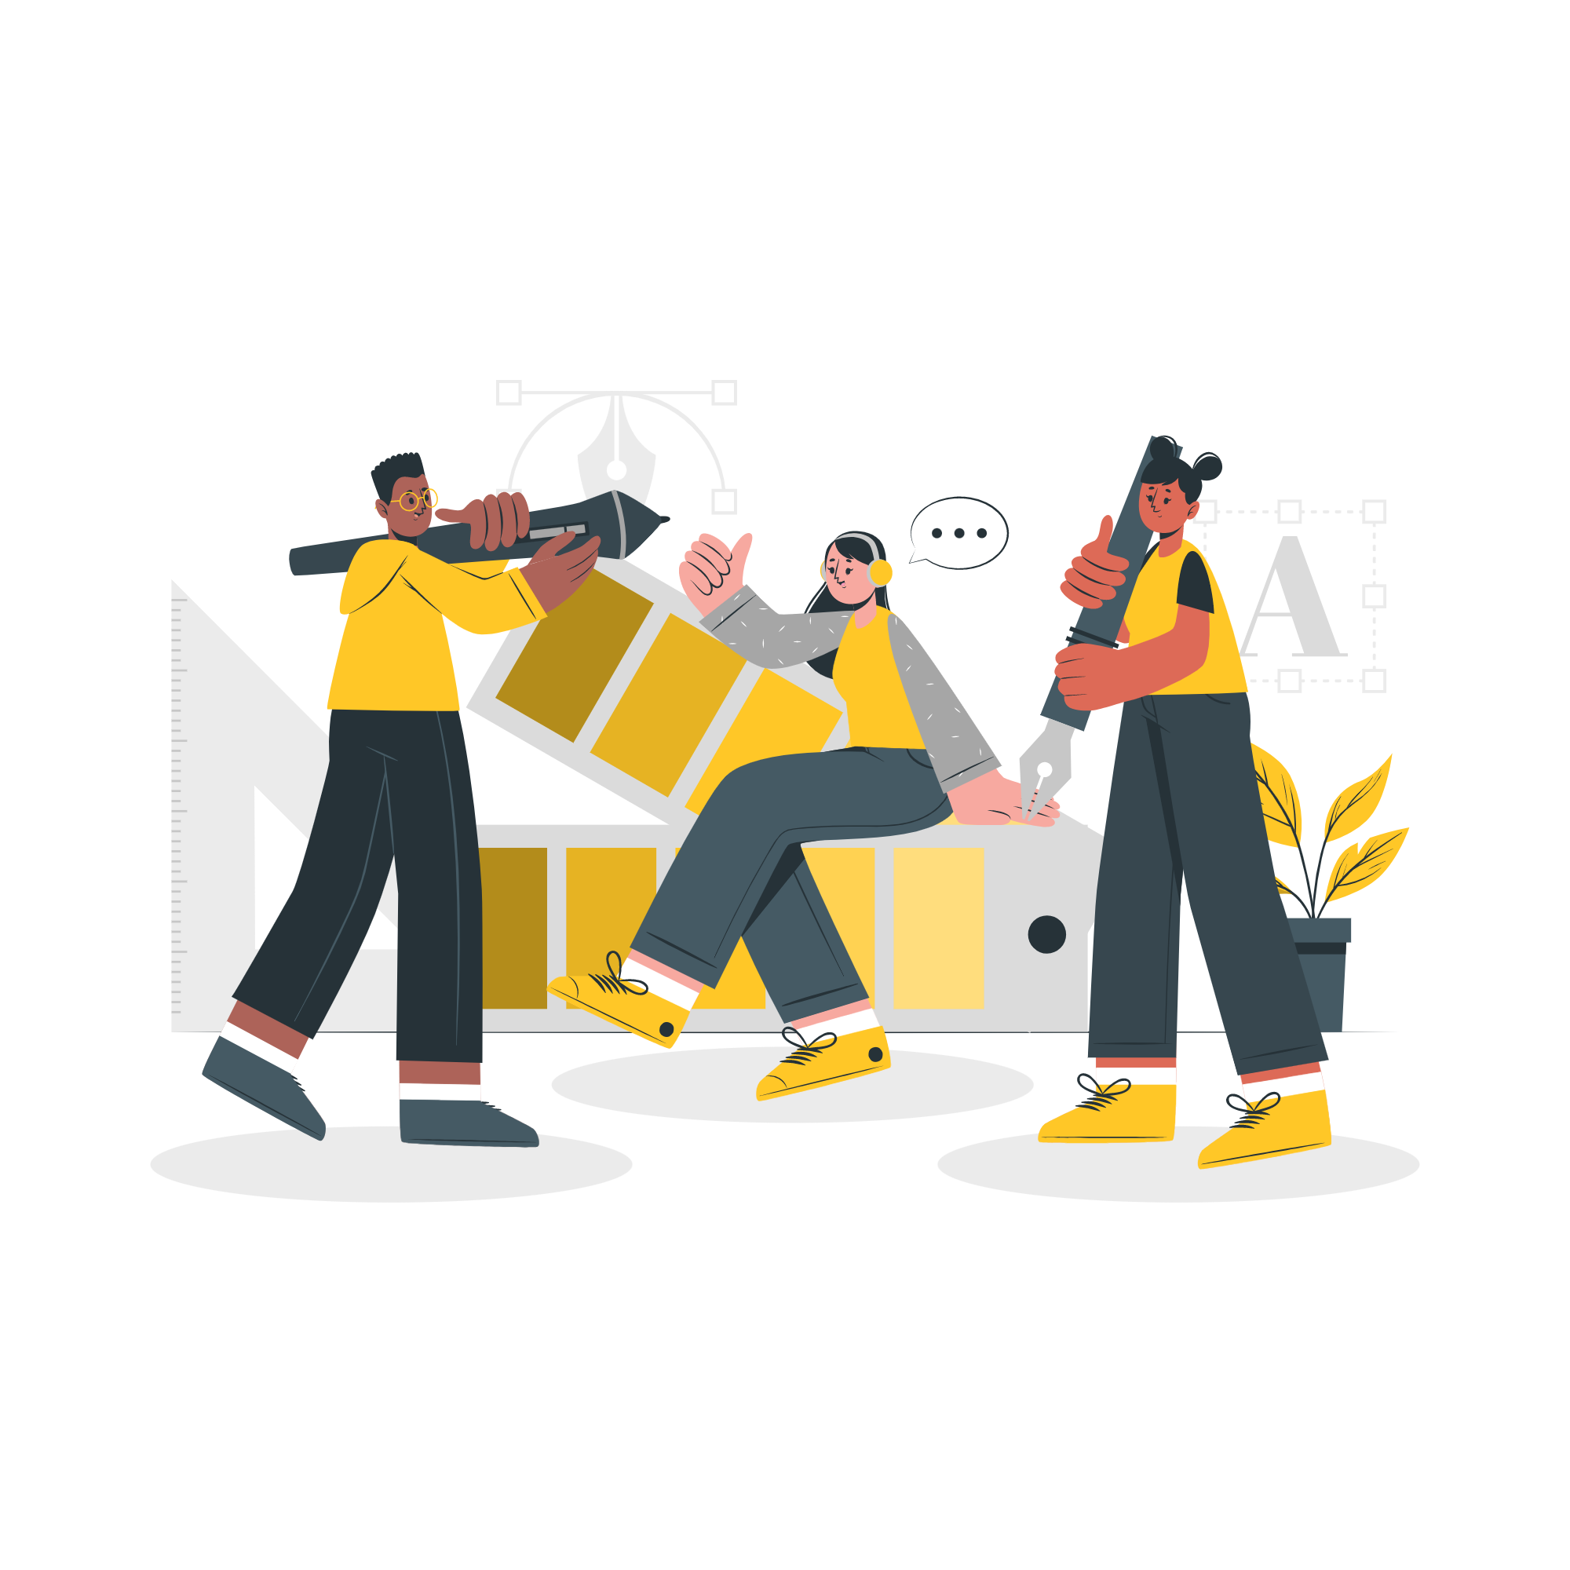

Storyset
Create your Story with our illustrated concepts. Choose the style you like the most, edit its colors, pick the background and layers you want to show and bring them to life with the animator panel! It will boost your presentation. Check out how it works.
Pana
Amico
Bro
Rafiki
Cuate

Slide 43
Use our editable graphic resources...
You can easily resize these resources without losing quality. To change the color, just ungroup the resource and click on the object you want to change. Then, click on the paint bucket and select the color you want. Group the resource again when you’re done. You can also look for more infographics on Slidesgo.

Slide 46
JANUARY
FEBRUARY
MARCH
APRIL
MAY
JUNE
PHASE 1
Task 1
Task 2
PHASE 2
Task 1
Task 2
JANUARY
FEBRUARY
MARCH
APRIL
PHASE 1
Task 1
Task 2

Slide 49


